Slide 1
A quick introduction to
ordinal regression
PSY 504 – 2/23/2026
Bianca Santi

Slide 2
Likert Scales
Rate __ from 1 to 7:
1
2
3
4
5
6
7
✔
2 + 4 + 5 = 11
11/3 = 3.67
✅ Average rating is 3.67
✔
✔
Notes:
Who knows what a Likert scale is?
If you have data from 3 people…
How do you summarize this data?
To summarize it, you could simply sum all 3 together and get the average response

Slide 3
Likert Scales
Rate __ from 1 to 7:
1
2
3
4
5
6
7
✅ Average rating is 3.67
Rate your happiness:
1 – very sad
2 – moderately sad
3 – slightly sad
4 – neutral
5 – slightly happy
6 – moderately happy
7 – very happy
❓Average rating is 3.67 happiness units?
Rate your agreement:
1 – strongly disagree
2 – disagree
3 – somewhat disagree
4 – neutral
5 – somewhat agree
6 – agree
7 – strongly agree
❓Average rating is 3.67 agreement units?
✔
✔
✔
✔
✔
✔
✔
✔
✔
Notes:
But it’s not that simple – what happens if the Likert scale is not simply a set of numbers? What does an average rating mean in these cases?

Slide 4
Ordinal data
Ordinal variables:
Have a natural order of categories
Strongly agree > agree > somewhat agree
Distance between variables is unknown and/or may be different across participants
Is (strongly agree - agree) > (somewhat agree > neutral)?

Slide 5
Ordinal data
Ordinal variables:
Have a natural order of categories
Strongly agree > agree > somewhat agree
Distance between categories is unknown and/or may be different across participants
Is (strongly agree - agree) > (somewhat agree > neutral)?
→ Can’t use models that assume equal intervals between response levels (metric models)
Notes:
This is the crucial difference between ordinal data and normal numerical data

Slide 6
Why does this matter?
Most (all?) papers that analyze Likert scale data use metric models like t-tests, ANOVA, and ordinary least squares regression (Liddell and Kruschke 2018)
Ordinal data violates assumption of (1) equal distance between response categories and potentially (2) normal distribution of responses and (3) equal variances across groups/conditions
Using metric models for ordinal data can lead to
Increased rates of false positives (Type I error)
Decreased rates of correct detection (Type II error)
Inversion of effect-size estimates between groups
Notes:
All in parentheses with question mark bc they analyzed data from 68 papers sometime in or before 2018 and found that all of them used metric models, but that doesn’t mean it’s still the case today

Slide 7
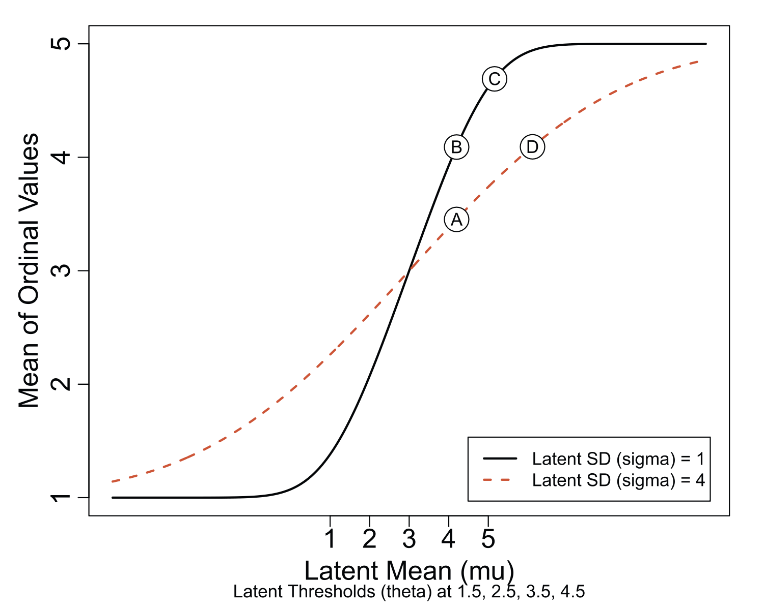
Why does this matter?
Liddell and Kruschke (2018)
Notes:
Plot showing two different curves for relationship between
the latent mean of a distribution for ordinal values → underlying true difference
the observed mean of the ordinal values → data you can see
Curves differ based on the standard deviation/variance used in the underlying distribution
Will explain more about the underlying distribution later on
Important thing here is that same value along the x axis is showing the same underlying parameter for the mean (what we care about)

Slide 8
Why does this matter?
Type I error (false positive):
Same underlying mean
Different ordinal means
Metric model captures differences in the ordinal means → incorrectly gives different estimates for the mean
Liddell and Kruschke (2018)

Slide 9
Why does this matter?
Type II error (false negative):
Different underlying means
Same ordinal means
Metric model captures differences in the ordinal means → incorrectly gives the same estimate for the mean
Liddell and Kruschke (2018)

Slide 10
Why does this matter?
Reversed effect sizes:
D > C in latent distribution
C > D for ordinal means
Metric model captures differences in the ordinal means → incorrectly estimates the directionality of the difference
Liddell and Kruschke (2018)
Notes:
Plot showing two different curves for relationship between
the latent mean of a distribution for ordinal values → underlying true difference
the observed mean of the ordinal values → data you can see
Curves differ based on the standard deviation/variance used in the underlying distribution
Will explain more about the underlying distribution later on

Slide 11
Why does this matter?
Ordinal data violates assumption of (1) equal distance between response categories and potentially (2) normal distribution of responses and (3) equal variances across groups/conditions
Using metric models for ordinal data can lead to
Increased rates of false positives (Type I error)
Decreased rates of correct detection (Type II error)
Inversion of effect-size estimates between groups
Even when averaging across response items
→ Need to use models that account for underlying distribution of ordinal data

Slide 12
Ordinal regression
Ordinal regression models model discrete ordinal variables that derive from underlying distributions without assuming equal distances between values
Three classes
Cumulative models
Sequential models
Adjacent-category models

Slide 13
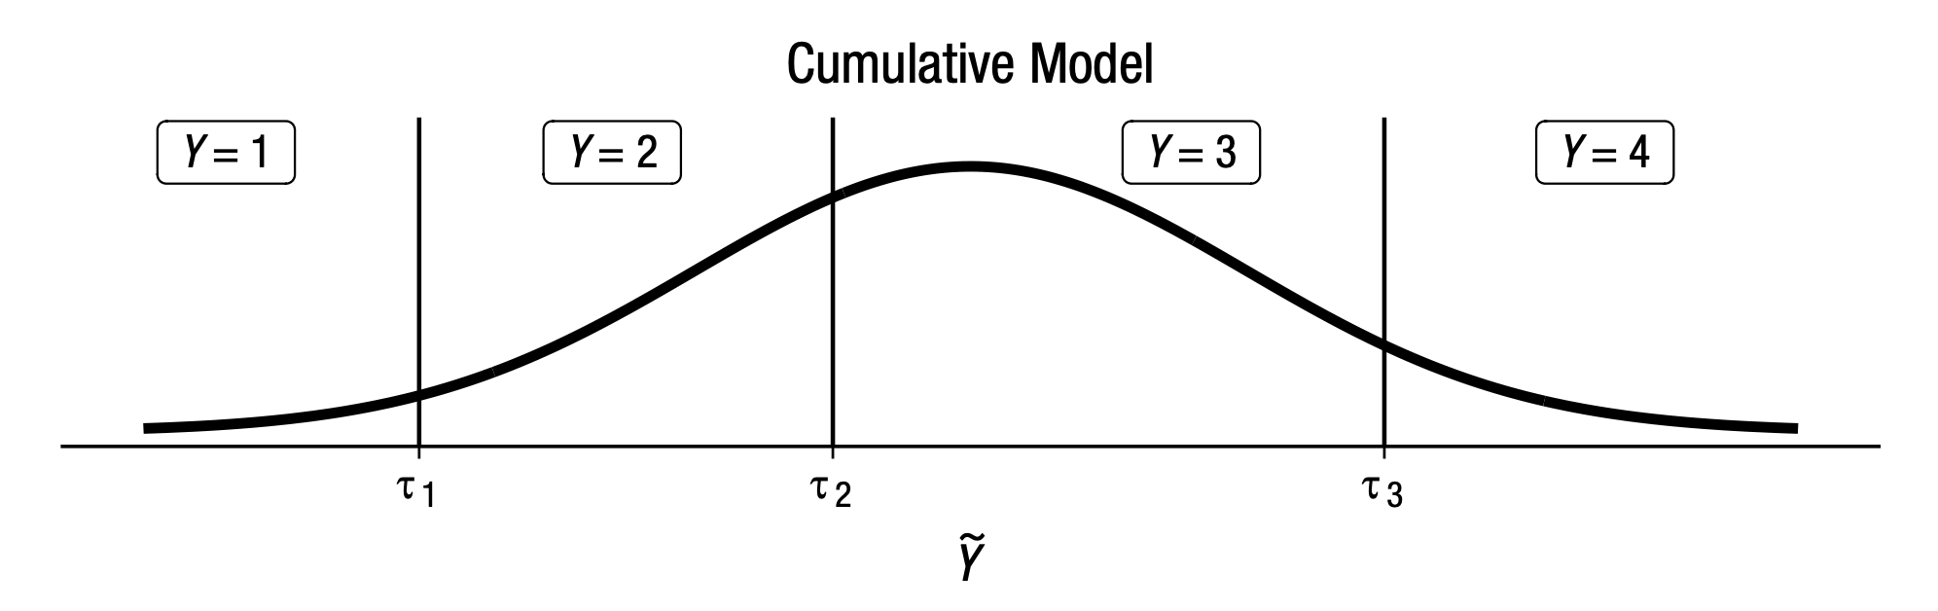
Cumulative models
Observed ordinal variable Y comes from categorization of latent continuous variable Ỹ
Interpret as categorization – discrete responses about a possibly continuous psychological variable (e.g., Likert scale data)
Bürkner and Vuorre (2019)
Notes:
Cutoffs = thresholds between one response and another
Distance between cutoffs is variable

Slide 14
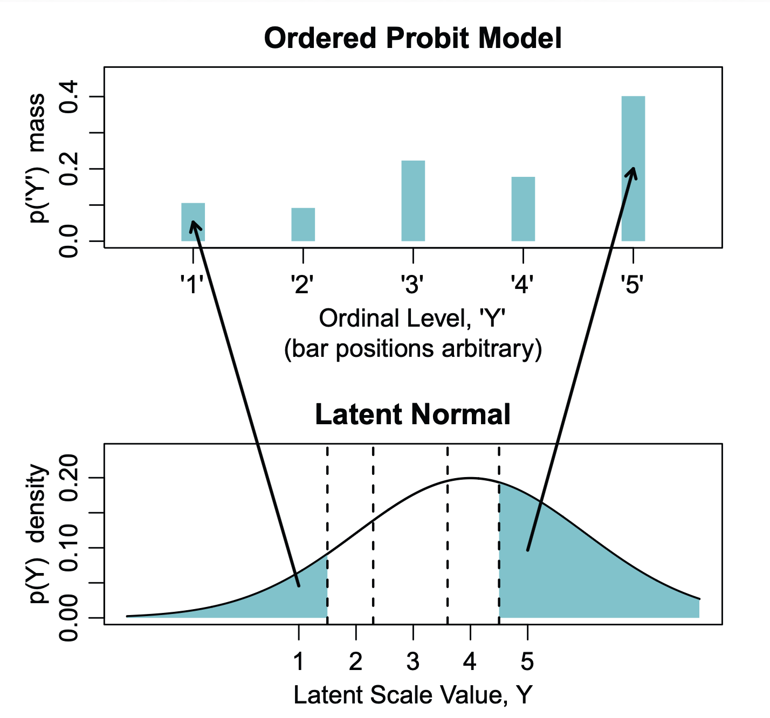
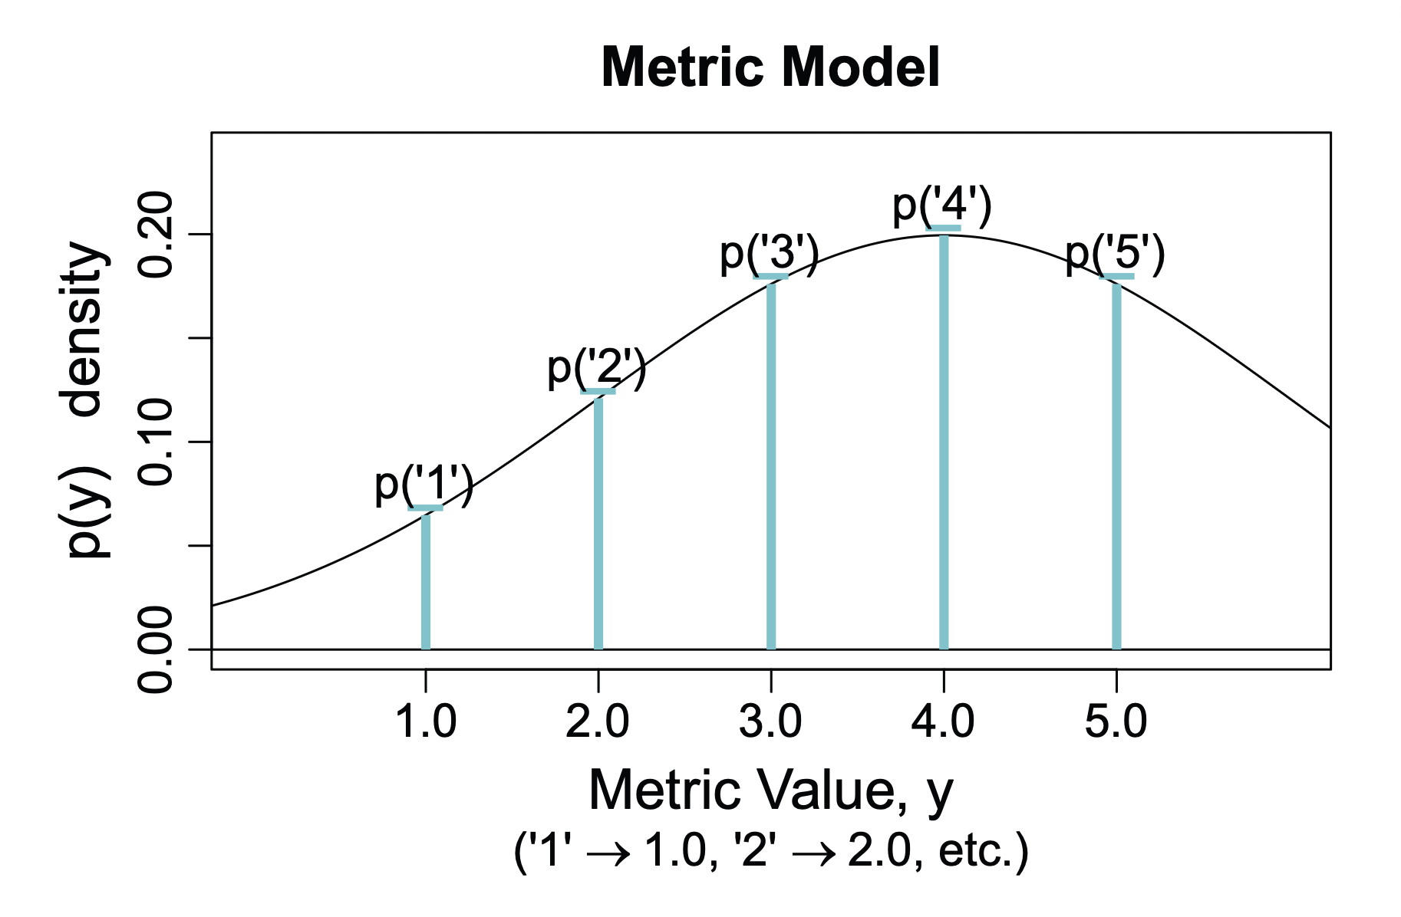
Cumulative model – ordered probit model
Liddell and Kruschke (2018)

Slide 15
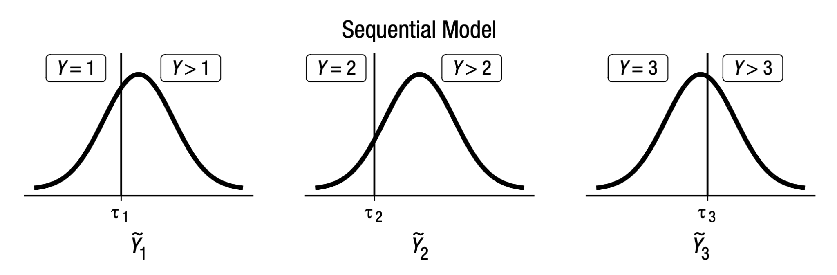
Sequential models
For every observed category Y there is a latent continuous variable Ỹ that determines the transition between one category and the next
Interpret as sequential process – a higher category is only possible if all lower categories have been achieved (e.g., years of marriage before divorce)
Bürkner and Vuorre (2019)
Notes:
For each category k, if the value for the continuous variable is greater than tau_k, sequential process can continue on to next category; if not, stop there

Slide 16
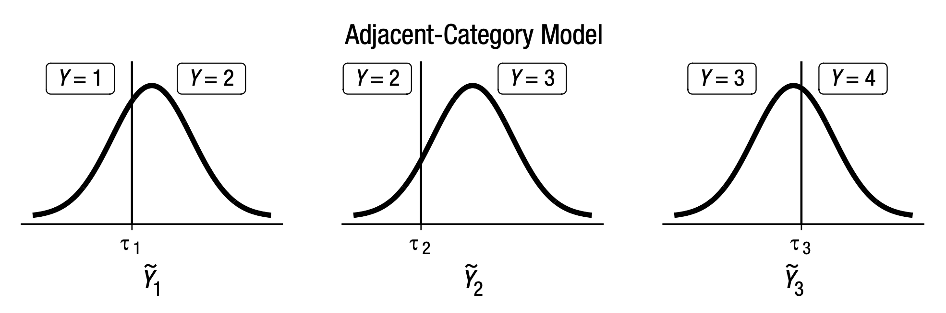
Adjacent-category models
For every observed category Y there is a latent continuous variable Ỹ that determines the transition between category Y = k and category Y = k +1
No specific interpretation, but more mathematically convenient and allows for modeling of category-specific effects
Bürkner and Vuorre (2019)
Notes:
Very similar to sequential models, but instead of modeling transition between one category and all possible greater categories you’re just modeling the transition between one category and the immediate next category

Slide 17
Ordinal regression – considerations
Category-specific effects
Different predictors may have different effects for different response categories (e.g., affects likelihood of definitely agree vs agree but not rest)
Can model category-specific effects by estimating coefficients for each category in adjacent-category and sequential models
Unequal variances
Variance of underlying distribution can vary as a function of predictors (e.g., different groups have different variances in ratings)
Can model unequal variances for all types of ordinal regression models

Slide 18
Ordinal regression – considerations
Bayesian or frequentist statistics?
Bayesian approach
Estimate posterior distribution and quantify uncertainty for each parameter
Can be slower (estimation based on MCMC) than decision based on maximum likelihood, but also more informative
brms package
Specify model type with family
Frequentist approach
Determine best-fitting parameter values based on maximum likelihood
Obtain p-values for whether parameters are significantly different from each other
clm() function from ordinal package or vglm() function from VGAM package for cumulative odds models

Slide 19
Thank you!
Questions?

